Slide 1
Secure Data Hiding In Images Using Steganography
CAPSTONE PROJECT
Presented By:
Student Name : Rathish.R
College Name & Department : Rajalakshmi Institute of Technology & Computer Science and Engineering.

Slide 2
OUTLINE
Problem Statement
Technology used
Wow factor
End users
Result
Conclusion
Git-hub Link
Future scope

Slide 3
Problem Statement
Traditional encryption methods raise suspicion, making them a target for hackers.
Sensitive data needs a Covert way of communication without drawing attention.
Cyber threats like Data Breaches and Espionage demand innovative security solutions.
Steganography allows hidden data transfer without Altering Visible File Properties.
It is widely used for Confidential Messaging , Watermarking and Anti-forensic Applications.

Slide 4
Technology used
Python is the core programming language for efficient steganographic operations.
OpenCV & GUI help process and manipulate images for data embedding.
LSB (Least Significant Bit) & DCT (Discrete Cosine Transform) are key techniques.
AES/RSA Encryption adds an extra layer of security before hiding data.
Hashing Algorithms (SHA-256) ensure integrity and authenticity of hidden messages.

Slide 5
Wow factors
Invisible Security – Hides data without altering the appearance of files.
Dual Protection – Can be combined with encryption for Enhanced Security.
Difficult to Detect – Well-implemented techniques are Almost Undetectable.
Multi-Purpose – Used in Covert Messaging, Copyright Protection, and Forensics.
Minimal Impact – Retains the quality of media files While Securely Embedding Data.

Slide 6
End users
Cybersecurity Experts – For penetration testing and secure communication.
Government & Intelligence Agencies – Used in Military Operations and Espionage.
Journalists & Activists – Helps bypass censorship and Protect Confidential Sources.
Digital Content Creators – Used for Copyright Protection and Watermarking.
Corporations & Businesses – Prevents Data Leaks and Intellectual Property Theft.

Slide 7
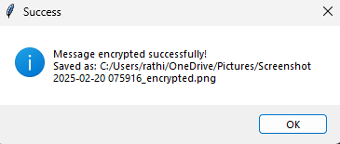
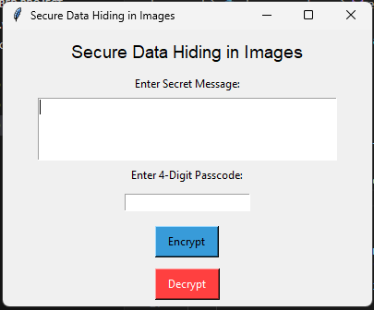
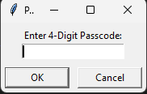
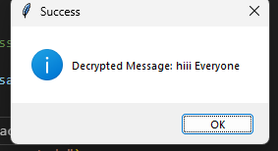
Results

Slide 8
Conclusion
Steganography is a Powerful Tool for secure, undetectable data transmission.
Unlike encryption, it doesn’t Raise Suspicion or attract attention.
Growing Cybersecurity Threats make steganography Highly Relevant Today.
Future advancements can make it Stronger, more Efficient, and widely adopted.
It is an essential technology in Privacy Protection, Forensic Security, and Covert
Communication.

Slide 9
GitHub Link
https://github.com/rathish1215/cyberproject.git

Slide 10
Future scope(optional)
AI-powered Steganography – Advanced techniques using machine learning for better hiding.
Blockchain Integration – Ensuring tamper-proof and verified secure messaging.
Real-time Video Steganography – Embedding data in live video streams.
Quantum Steganography – Future-proof security using quantum cryptographic principles.
Cloud-Based Secure Data Hiding – Implementing steganography for encrypted cloud storage.

Slide 11
THANK YOU

